Slide 1


Employment in HTEC across the EuropeaN Union (2010-2019) and it‘s impact on immigration dataset from the EU commission: https://ec.europa.eu/eurostat
Ironhack-Berlin
10.07.2020

Slide 2

HTEC (High-Tech) sector is defined as industries having high concentrations of workers in STEM occupation.

Slide 3
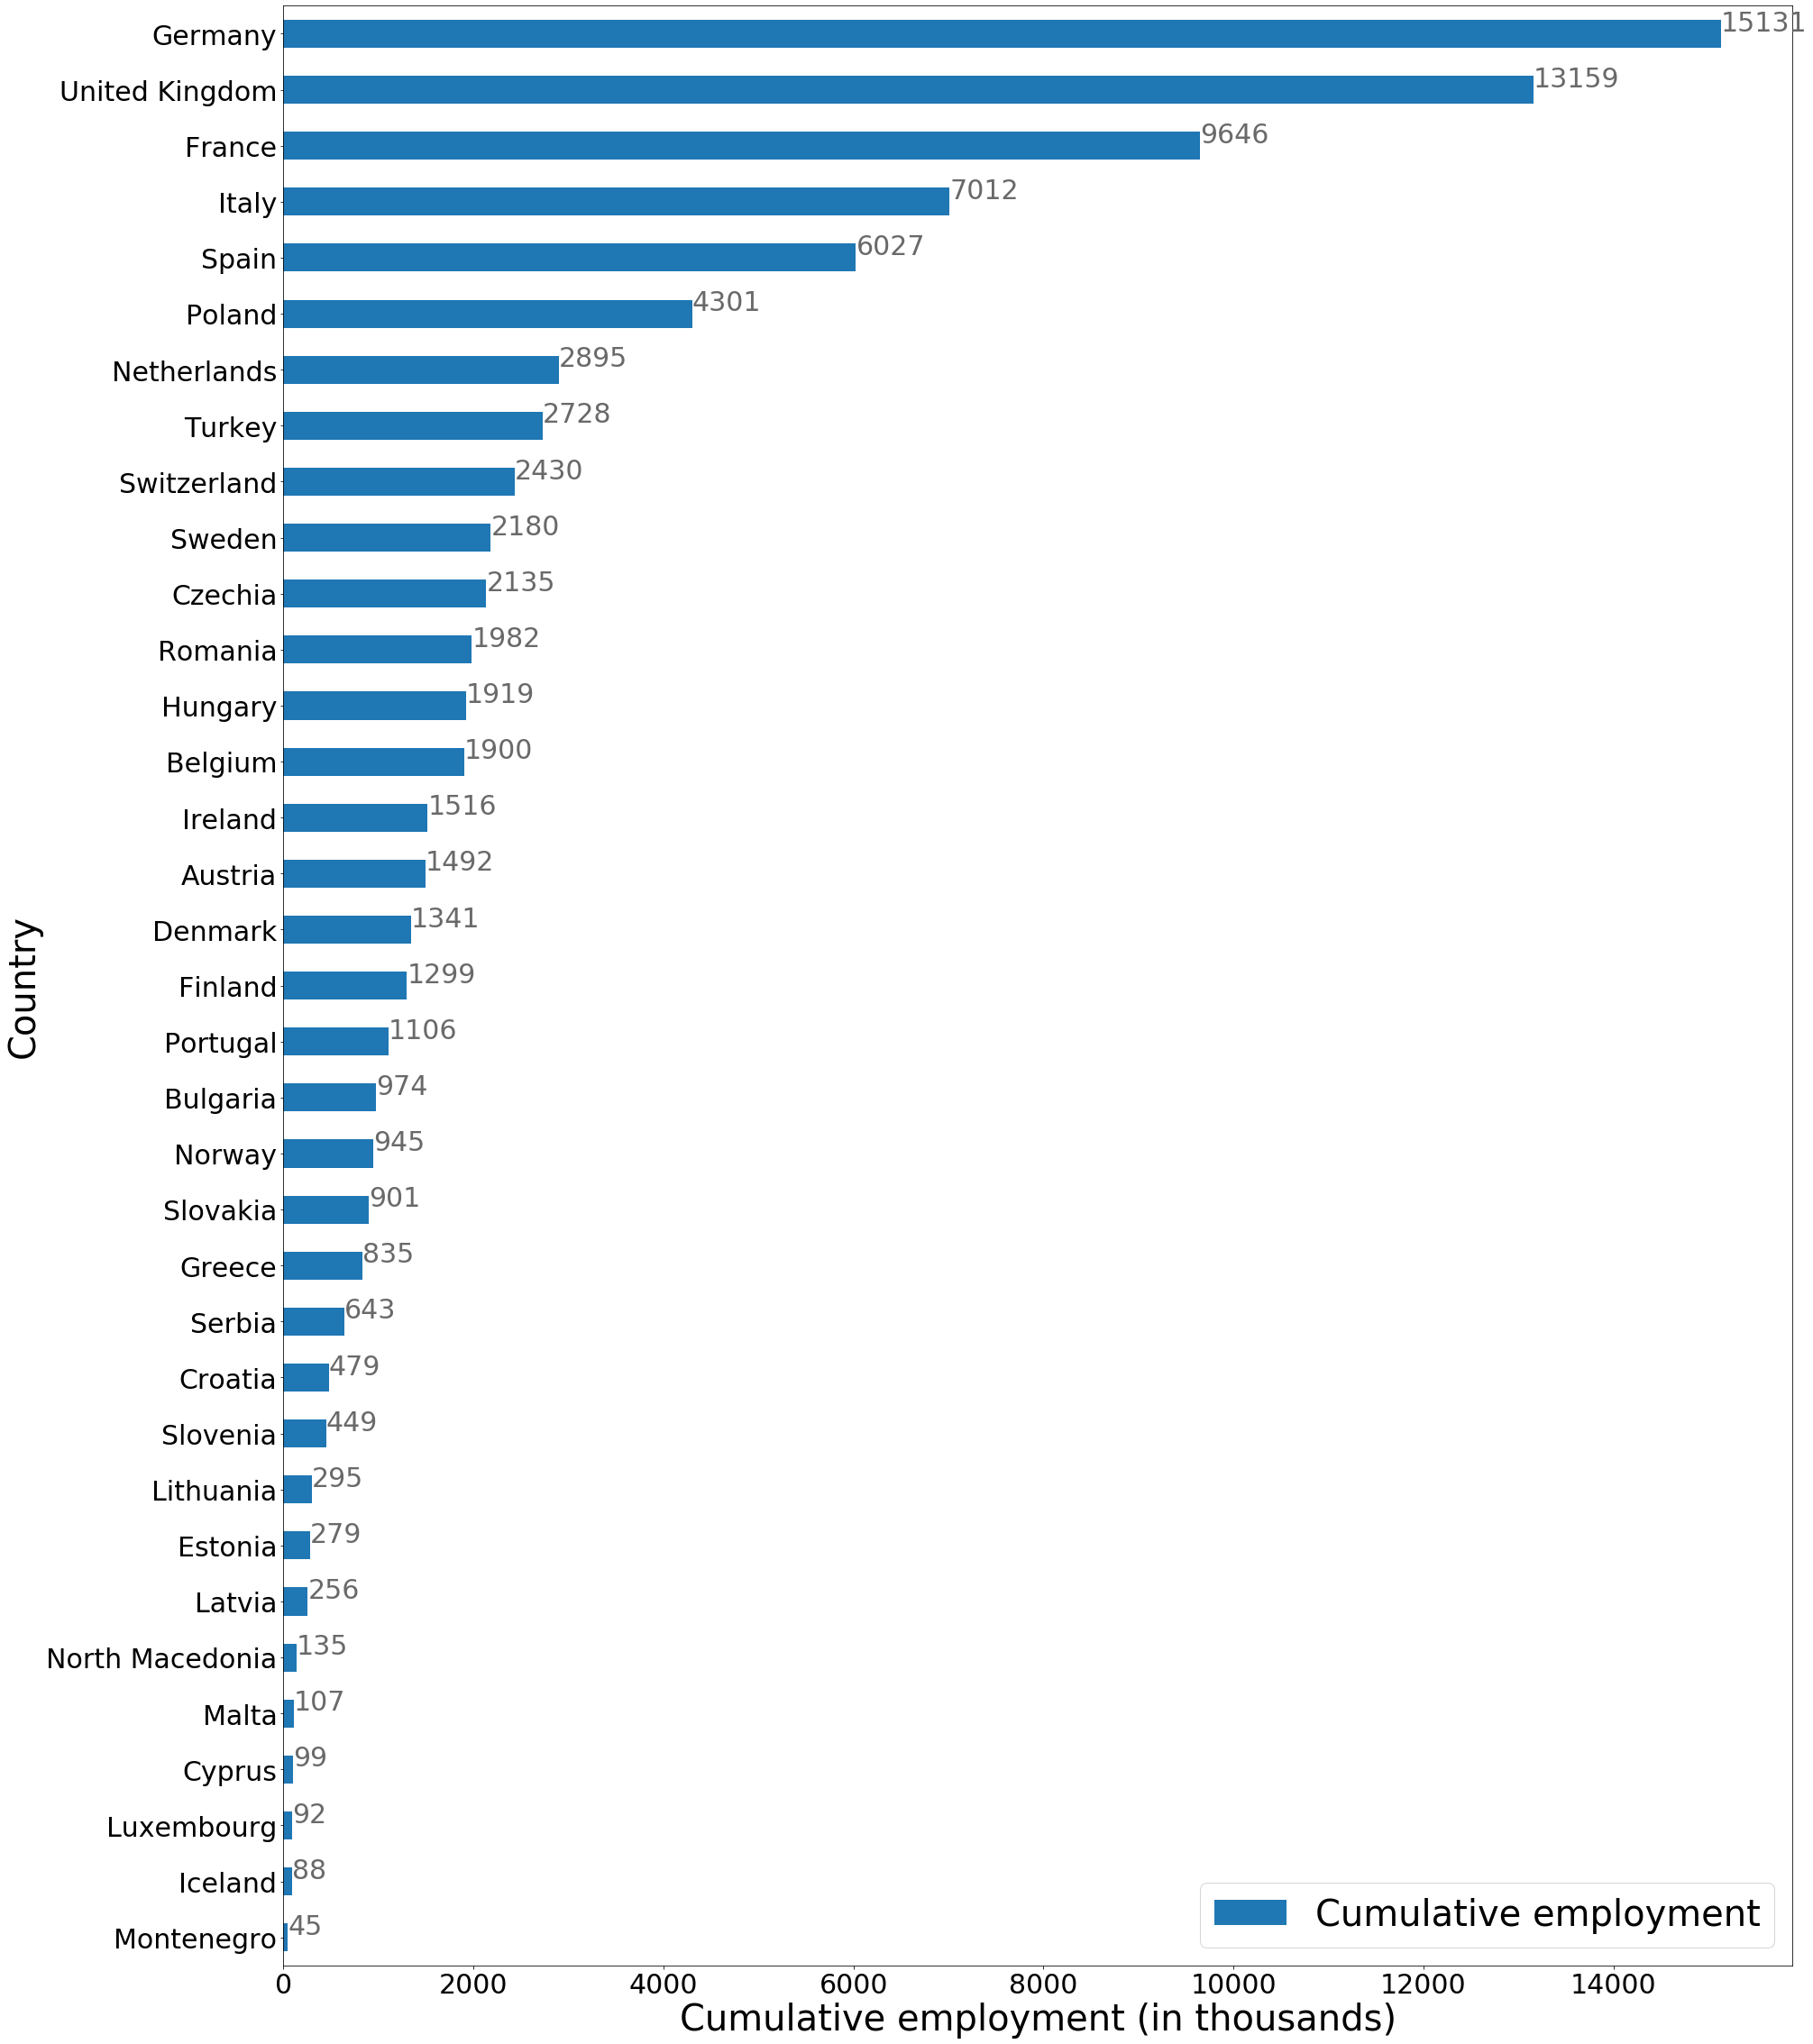
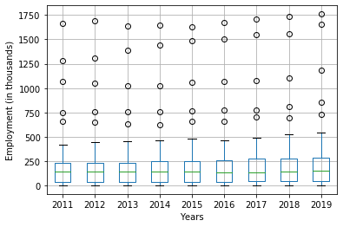
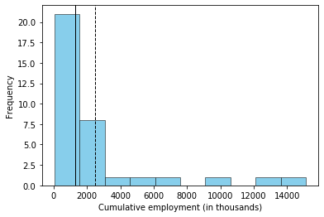
Q3= 2305k
Q2= 1300k
Q1= 372k
Average=2480k
Q1= 372k
Median=1300k

Slide 4
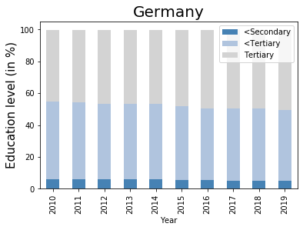
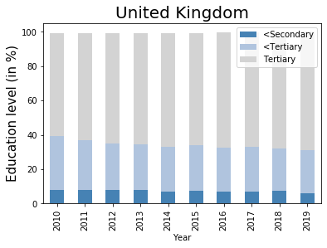
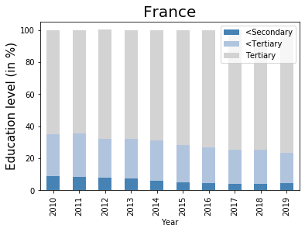
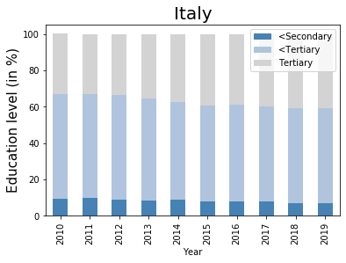

Slide 5
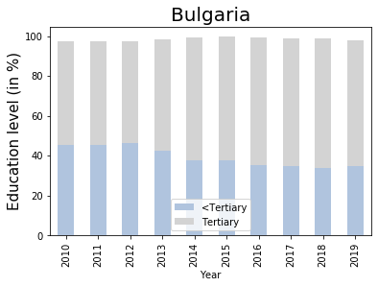
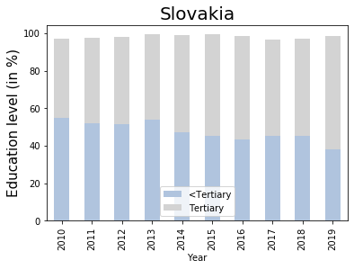
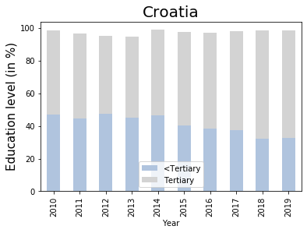
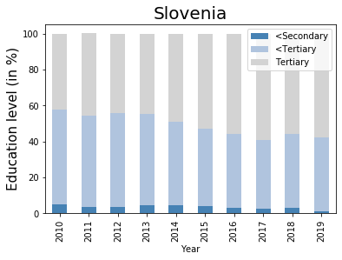

Slide 6
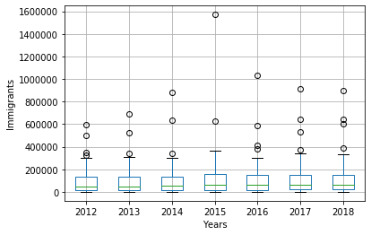
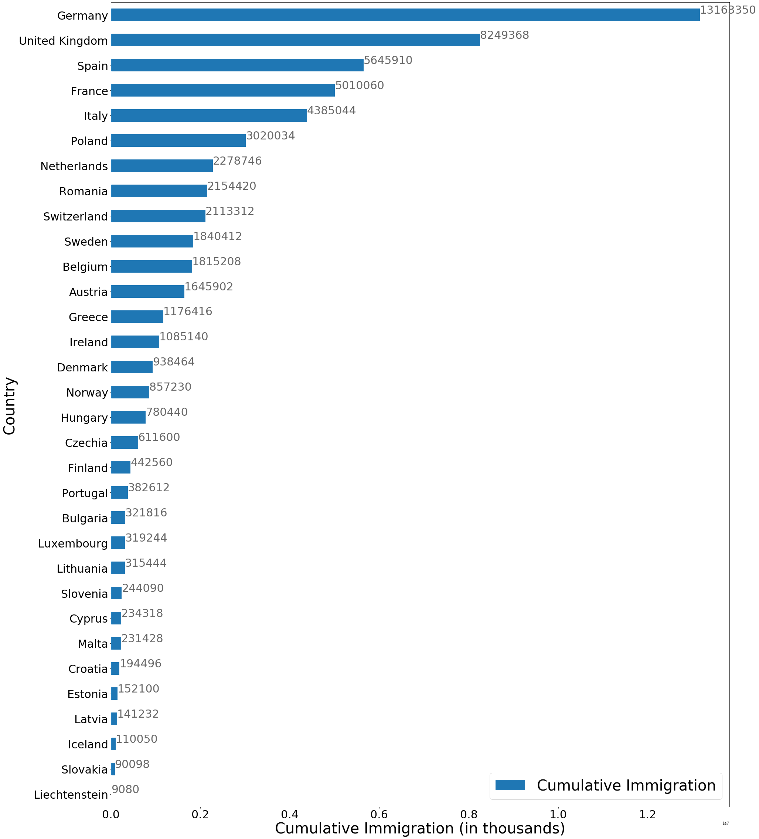
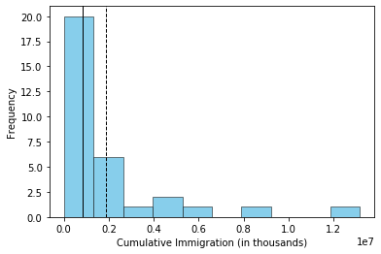
Average=1.8M
Median=820k

Slide 7
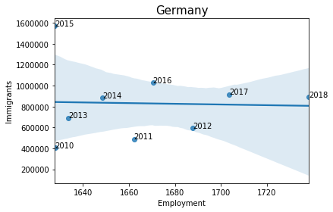
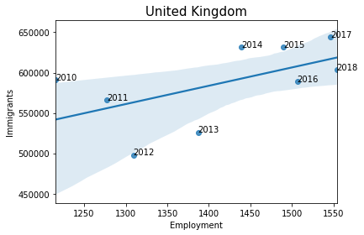
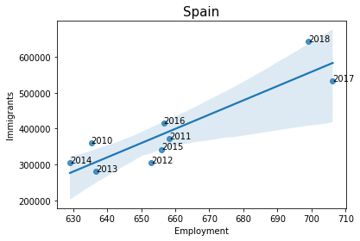
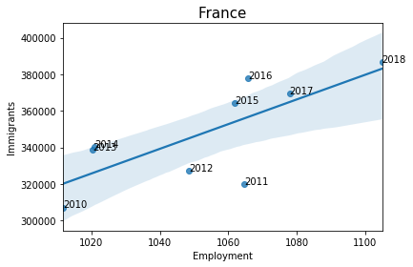
R²=0.863
R²=0.994
R²=0.941
R²=0.997

Slide 8
Summary (2011-2019):
Steady employment rate in the HTEC with 50% of countries employing up to 1300k in total.
Top 4 countries employing in HTEC: Germany, UK, France, Italy
40%-60% of all employed in HTEC have at least a Bachelor‘s degree.
Steady immigration rate with 50% of countries with up to 820k in total
Top 4 countries with immigrants: Germany, UK, Spain, France

